Slide 1
OPEN INNOVATION – OLD TRAFFORD MUSEUM TOUR EXPERIENCE
RedDevils1999
Kushal Lokesh
Khushal Sukhadia

Slide 2
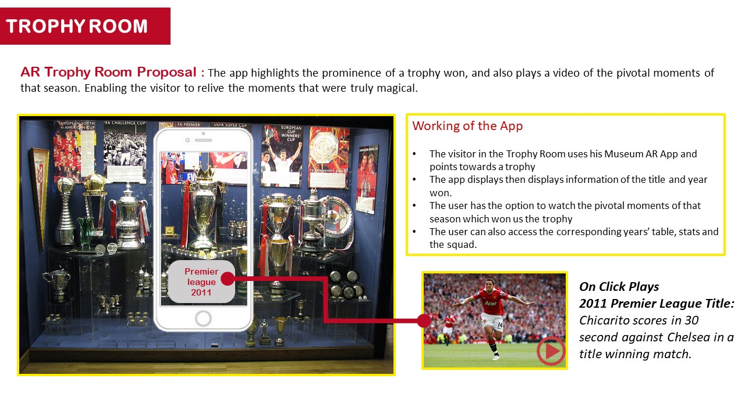
MUSEUM TOUR
The Proposal

Slide 3
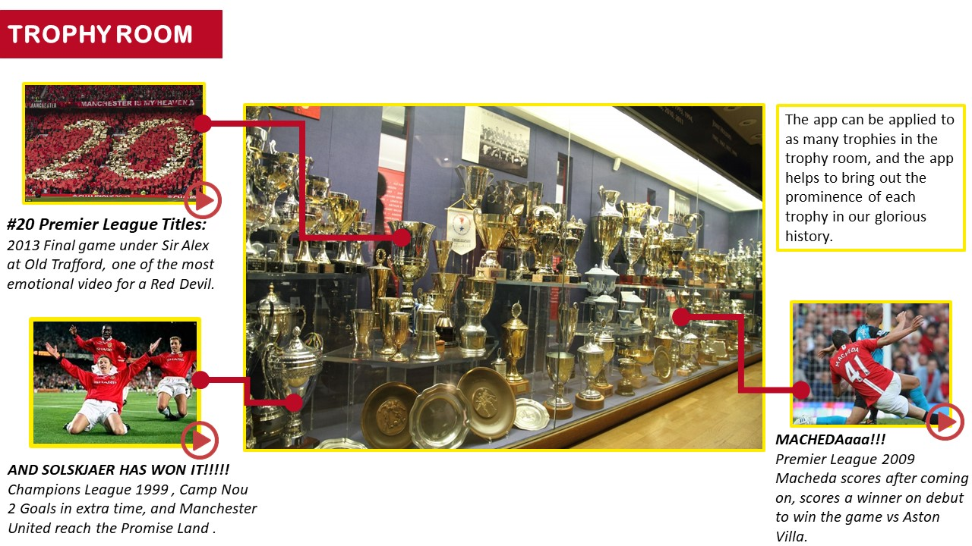
MUSEUM TOUR
The Proposal

Slide 4
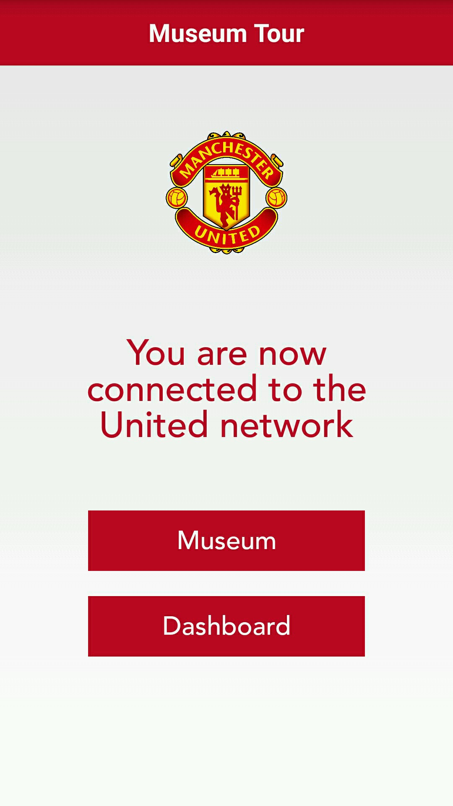
MUSEUM TOUR
Prototype
To demonstrate the working of the idea, we have made a prototype application.
We have taken five trophies of varied complexities and assigned it to various trophies won by Manchester United over the years. We are trying to mimic the trophy room scenario at Old Trafford. The trophies are scanned using the app and are recognized. Information like match statistics and videos can be played for each of the trophies.
Click here to watch the video

Slide 5
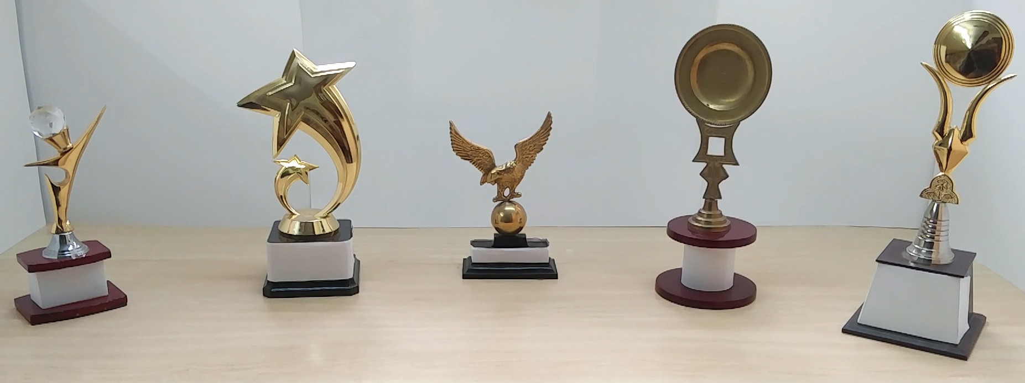


MUSEUM TOUR
Champions League 2008
Shield 2017
Instructions
Click here to download the .apk file on an Android phone (Marshmallow or previous versions)
For the working of the prototype, the phone must be connected to the internet
Allow the app to access the Camera and Storage. Select the Museum Tour option. Point the camera to the set of images to see the working of the app
EFL Cup 2017
Premier League 1993
Premier League 1997
Upon recognizing the object, the corresponding trophy opens up
Click here to see the entire wireframe

Slide 6
MUSEUM TOUR
Prototype Technical Details
Prototype Workflow
Application type | Android Application Compatible with Android Lollipop, Android Marshmallow
Permissions | Camera, storage
Backend | PHP
Database | MySQL
Programming language used | Java for mobile application. Screens are designed using xml
Framework | SaaS (Software as a Service)
External Libraries | CraftAR Cloud Image Recognition API
Images of the trophies are pre-fed to the cloud
PHP Back-end
Identifies the unique ID and sends the corresponding information
CraftAR Cloud
Queries are compared with the pre-fed images. Once a match is found, the unique ID of the image is returned
Museum Tour App
Camera scans images. Sends queries to the cloud

Slide 7
MUSEUM TOUR
CraftAR Image Recognition
External Library : CraftAR Cloud Image Recognition API
The backbone of our application is the external library used. It is a lightweight, highly accurate library which can be scaled up for a large application.
CraftAR is also available for iOS devices . For devices running operating systems other than Android or iOS, we can use JavaScript to make a web application.
The library has been tested for difficult angles, low-light conditions and highly reflective objects. The accuracy and versatility of the application can be seen in the demo video shown earlier.
We have used the Finder Mode for scanning of objects. In this mode, continuous queries are sent to the server until a result is found. This provides a very seamless experience to the user
Download the library
https://github.com/Catchoom/craftar-php
https://catchoom.com/documentation/image-recognition-sdk/android-image-recognition-sdk/classes/

Slide 8
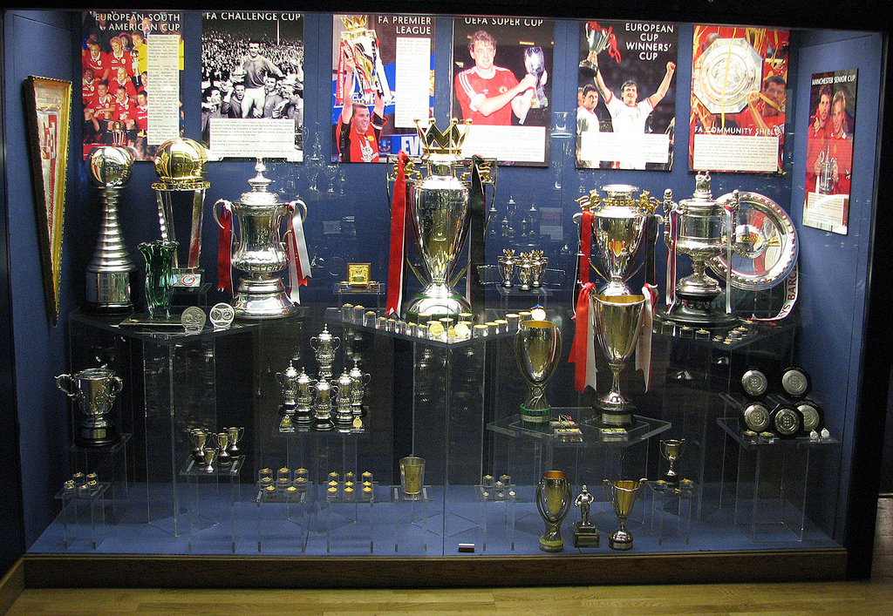
MUSEUM TOUR
Deployment and Scalability
For the deployment of the app, each of the trophies in the trophy cabinet will have to be scanned in the real lighting conditions from various angles.
In the prototype, the images are stored in the cloud for ease of demonstration. For the deployment, ‘On-Device Image Recognition’ library of CraftAR could be considered.
We could also explore the possibility of streaming the content from a local server which will retain the features of a cloud without using the internet.
PHP based backend admin panel to manage content easily and dynamically

Slide 9
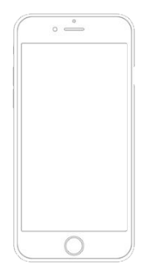
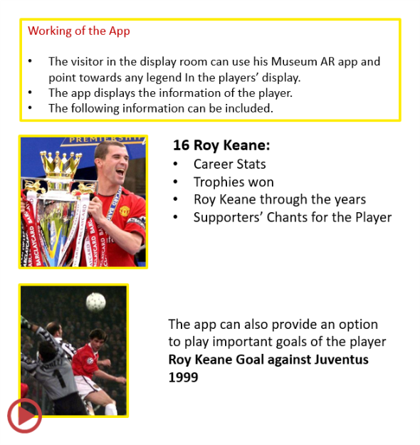
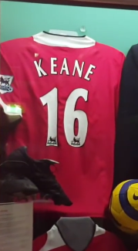
PLAYERS CORNER
Deployment and Scalability
The proposal for Players Corner is on the same lines as the trophy recognition.
Deployment of this feature will require taking pictures of all the jerseys.
The proof of concept is demonstrated in the previous slides
The Proposal

Slide 10
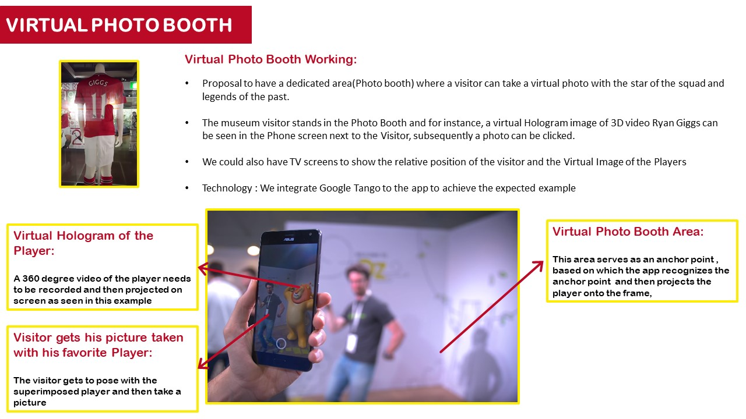
VIRTUAL PHOTO BOOTH
The Proposal

Slide 11
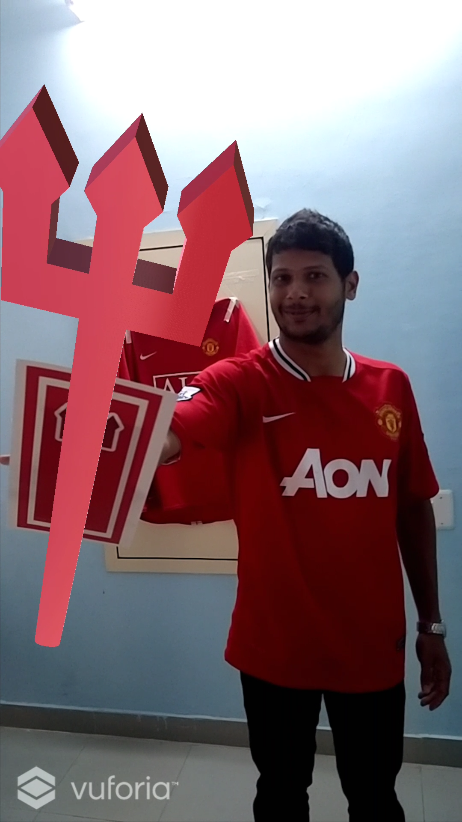
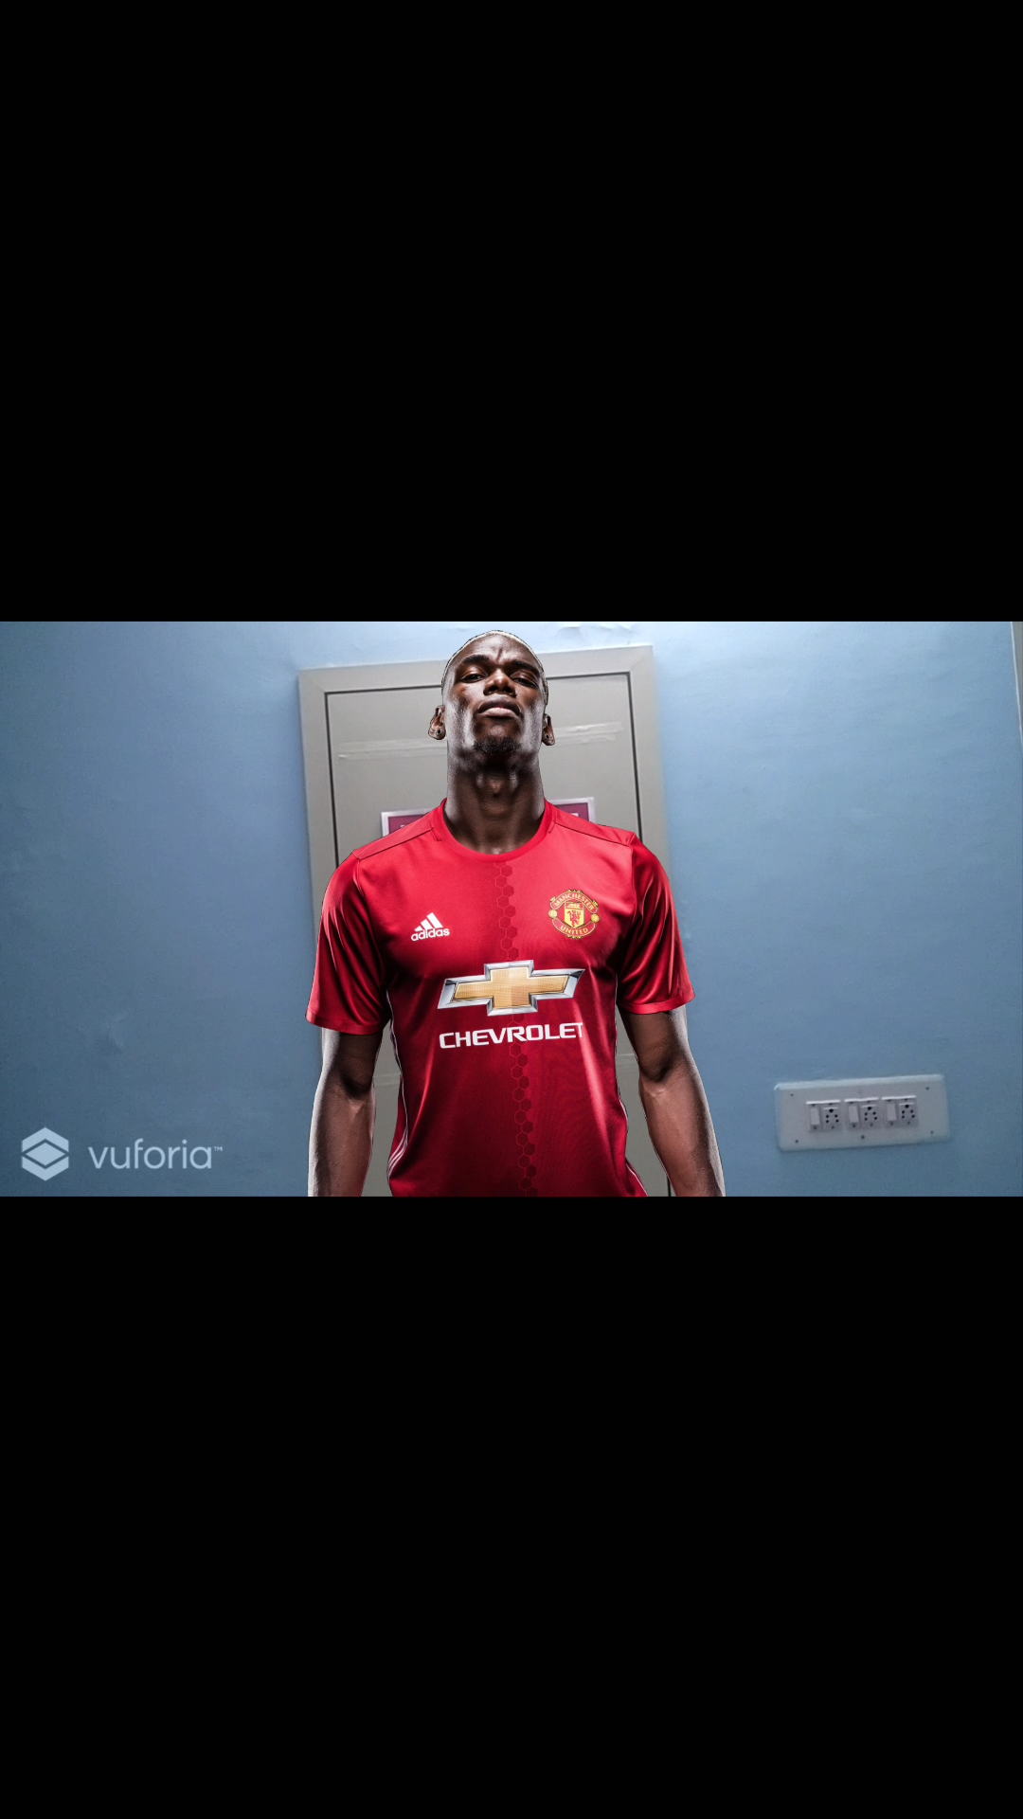
VIRTUAL JERSY
VIRTUAL PHOTO BOOTH
Prototype
To demonstrate the working of the idea, we have made a prototype application.
Click here to watch the video

Slide 12
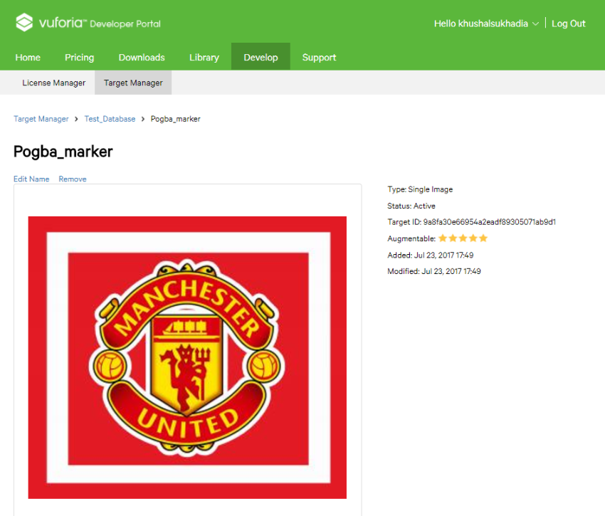
VIRTUAL JERSY
VIRTUAL PHOTO BOOTH
Markers
Markers are patterns that the phones/computers recognize with the camera input. Each marker is associated with a different virtual object
The markers are made using Vuforia Developer Portal and integrated with Unity 3D. Vuforia analyses the markers for their quality and readability.
Markers to be used are designed so as not to look out of place in the scenario.

Slide 13
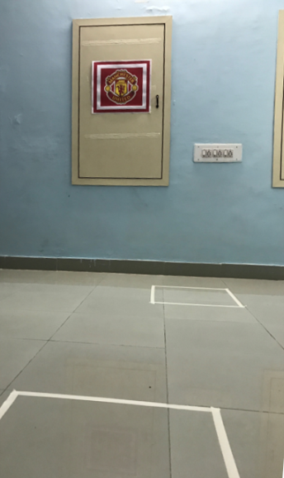


VIRTUAL JERSY
VIRTUAL PHOTO BOOTH
Working of Prototype
The app recognizes pre-fed custom markers which are scanned by the phone’s camera.
Once the markers are recognized, it’s corresponding image / 3D animation appears on the screen.
With the appropriate 3D rendering and when seen from the phone, this gives an impression that the virtual 3D object is part of the scenario.
This can be captured as still shots by taking screenshots of the phone

Slide 14
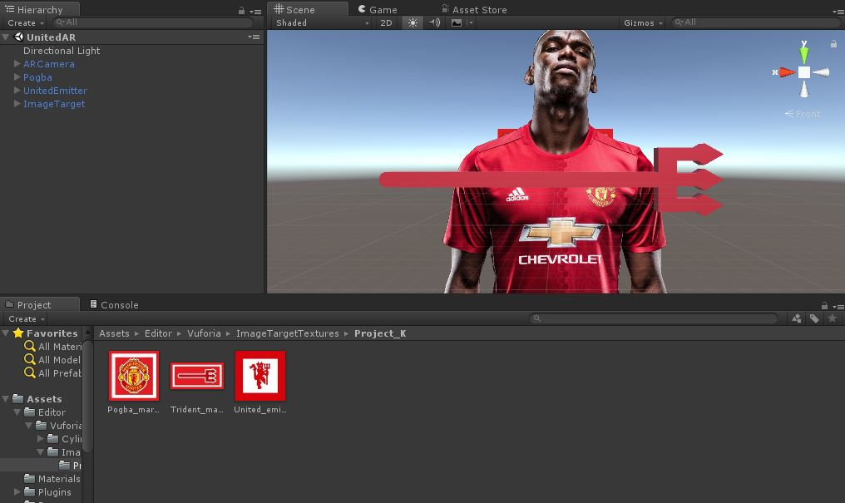
VIRTUAL JERSY
VIRTUAL PHOTO BOOTH
Rendering Using Keyshot and App Development in Unity3D

Slide 15
VIRTUAL JERSY
VIRTUAL PHOTO BOOTH
Technical Details
Workflow
Unity 3D
The markers are to be uploaded and configured with a virtual object. This is then converted to a mobile application and uploaded to the mobile
Application type | Android Application Compatible with Android Lollipop, Android Marshmallow
Permissions | Camera
External Libraries | Unity 3D, Vuforia
Virtual Photo Booth App
Scan the surroundings with the phone’s camera. Once the marker is identified the corresponding virtual image appears on screen

Slide 16



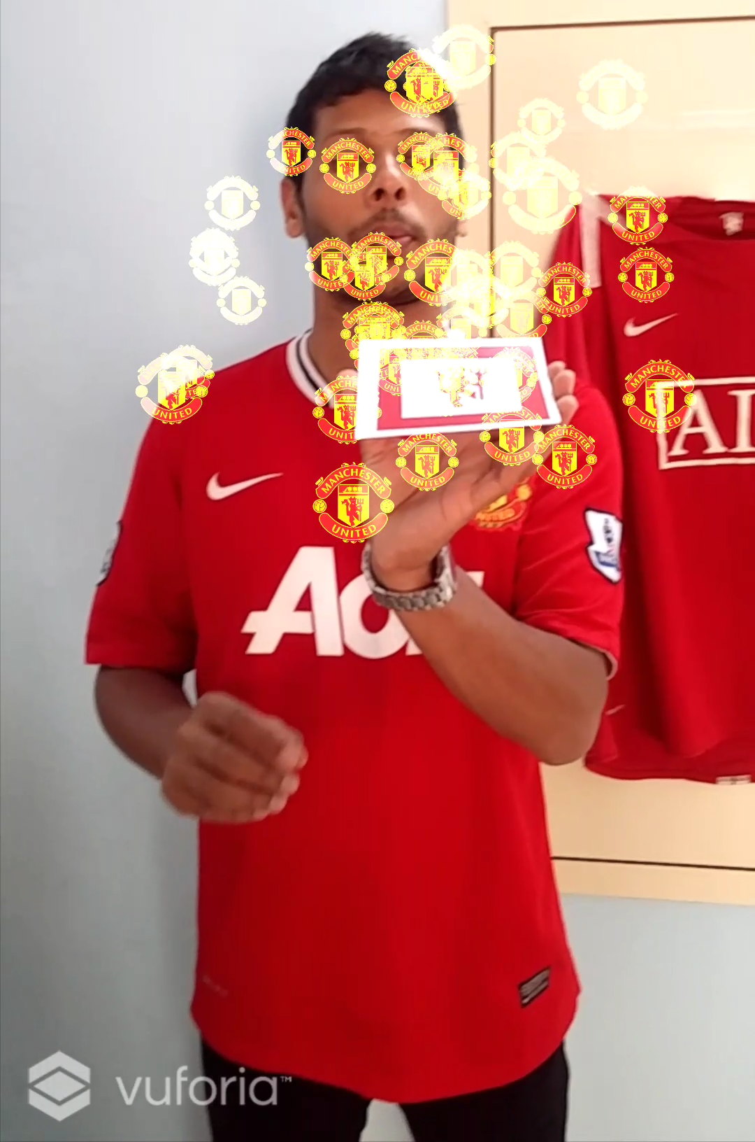
VIRTUAL PHOTO BOOTH
Prototype
Virtual Photo Bhooth
Marker

Slide 17
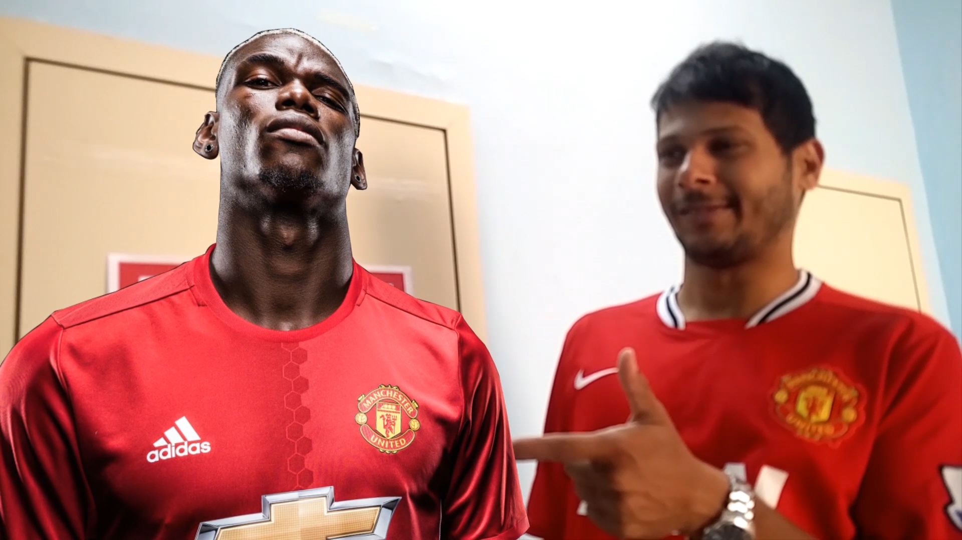
VIRTUAL JERSY
VIRTUAL PHOTO BOOTH
Instructions
Click here to download the .apk file on an Android phone (Marshmallow or previous versions)
For the working of the prototype, the phone need not be connected to the internet
Allow the app to access the Camera. Point the camera to the set of images to see the working of the app.

Slide 18
VIRTUAL PHOTO BOOTH
Unity 3D & Vuforia
External Library : Unity 3D & Vuforia
The backbone of this feature is Unity 3D application. It provides real-time entertainment in the space of Augmented Reality.
Both the applications are built for multiplatform integration and seamless working.
The possibilities in Augmented Reality are endless with this integration
The accuracy of markers and their identification from a far distance is crucial to the success of an Augmented Reality application. With the apt lighting, and accurate 3D rendering of the players, screen records from virtual photo booth can seem very realistic.

Slide 19

VIRTUAL JERSY
VIRTUAL PHOTO BOOTH
Area Demarcation, Deployment and Scalability
Once the markers are made of appropriate size and configured with the respective virtual object, we must assess the area from where the snapshots needs to be saved and the place where the virtual image would appear.
This is done to keep the perspective of the virtual image and the person appearing alongside.
We have demonstrated three scenarios
With Paul Pogba
With the Manchester United Trident
With Manchester United logos emanating from the Red Devil
The possibilities are endless to develop unique scenarios, especially with the rapidly developing Augmented Reality space with blurs the line between reality and imagination. We may use animated virtual objects to make the scene seen as realistic as possible.
Marker
Virtual Image
Standing Spot
Shooting Spot

Slide 20
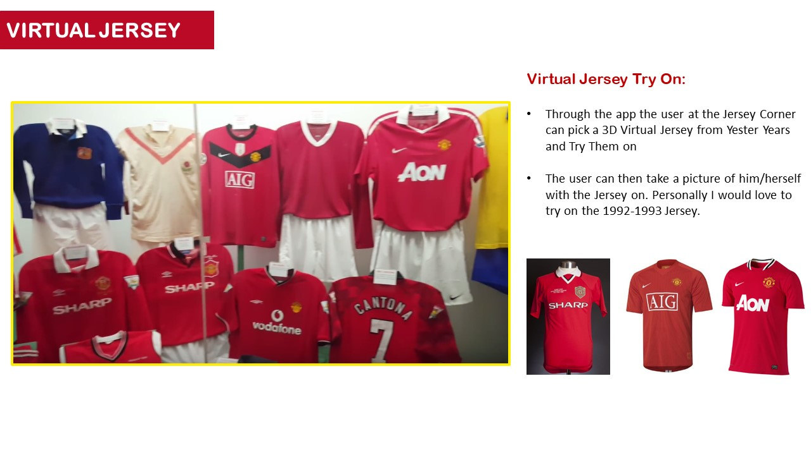
MUSEUM TOUR
The Proposal

Slide 21
VIRTUAL JERSY
Prototype and Deployment
This is a proven concept for various applications
It can be executed in multiple ways
Identifying particular pixels and replacing with them with corresponding pixels of the Manchester United Jersey https://github.com/akash0x53/virtual-dressing-room
Identifying the body outline of the person standing in front of the camera and overlaying the 3D object, in this case the jersey, on the user https://github.com/anthonyheckmann/KinectDressingRoom
Both the concepts are well proven and are executable using different programming languages.
Applications and services from AR tools like Unity 3D and CraftAR are used to make the Virtual Jersey. A big part of the algorithm and proof of concept overlaps with the Museum Tour and Virtual Photo Booth concepts demonstrated earlier

Slide 22
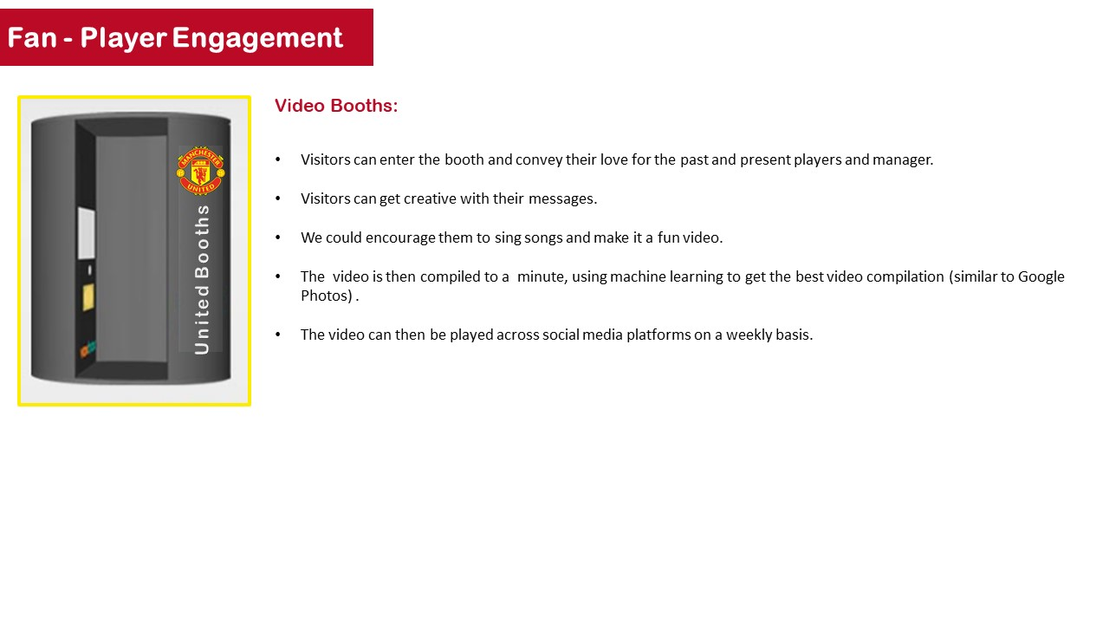
Fan – Player Engagement
Deployment
The proposed idea alongside, coupled with the Virtual Photo Booth and Virtual Jersey will make it a very interactive and engaging experience for the fans.
All the previous features can be integrated with popular social media platforms to increase fan engagement.
The Proposal

Slide 23
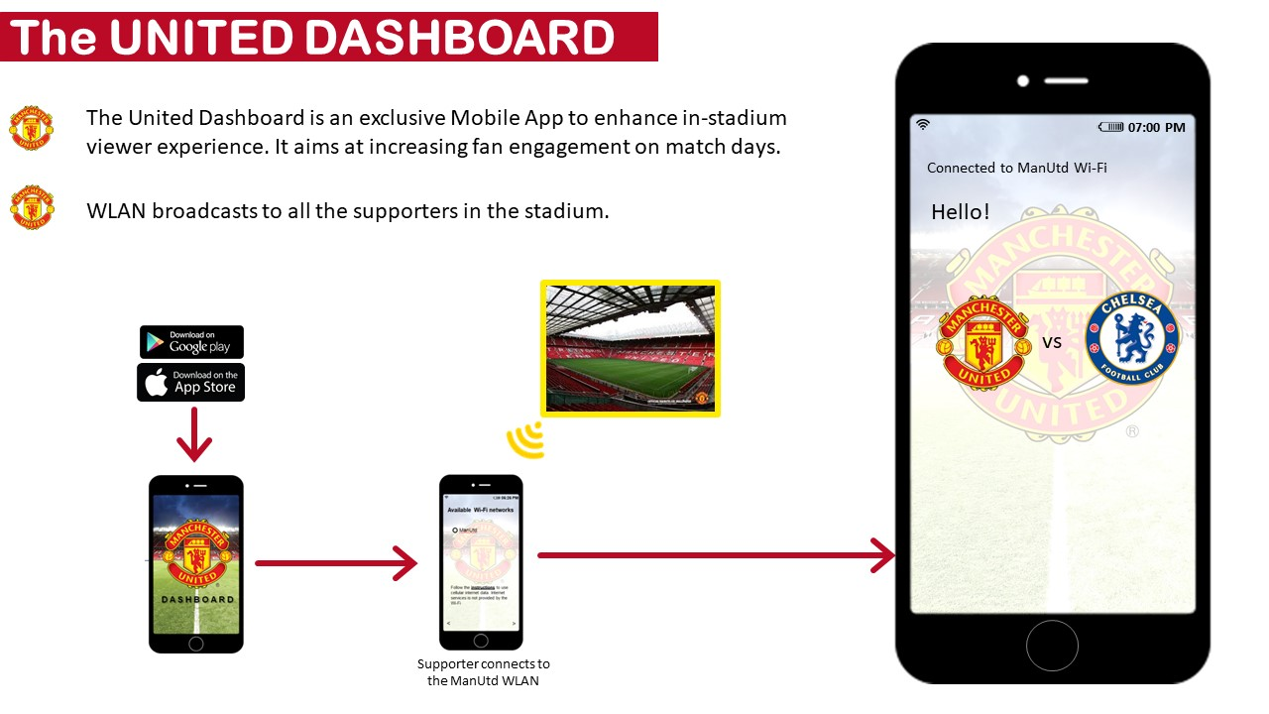
THE UNITED DASHBOARD
The Proposal

Slide 24
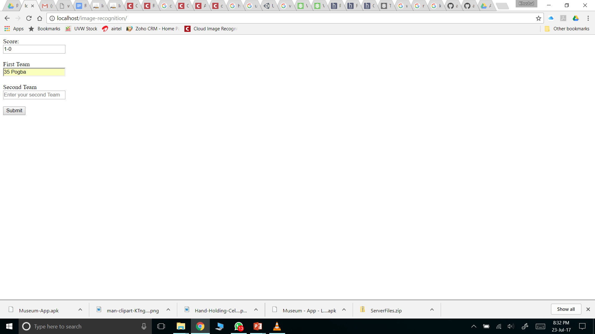
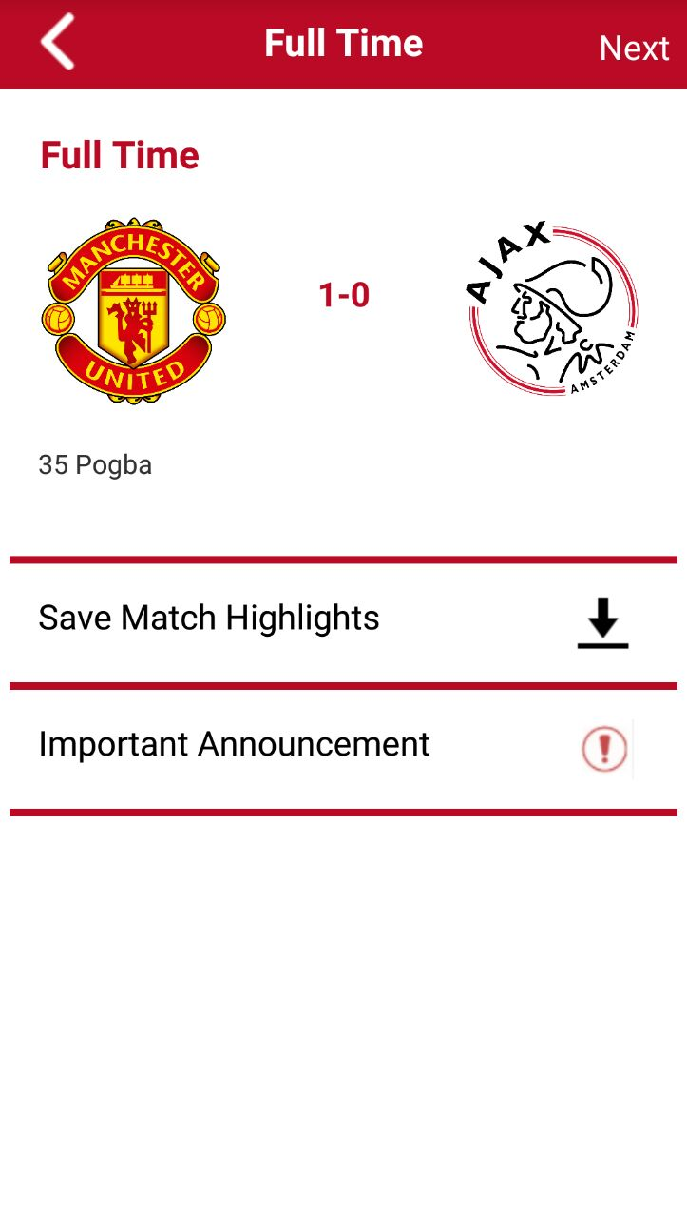
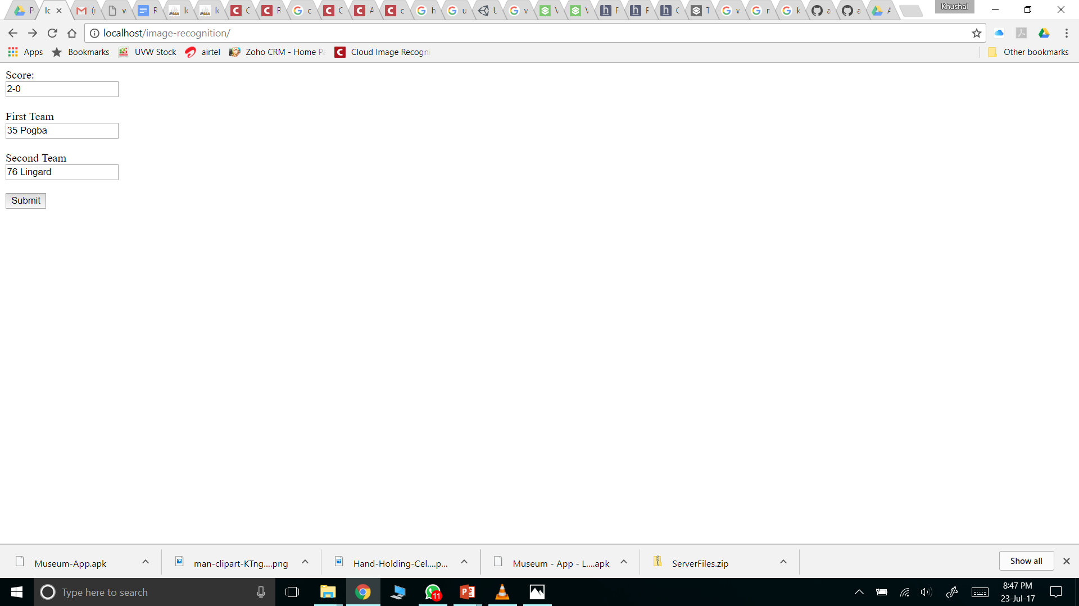
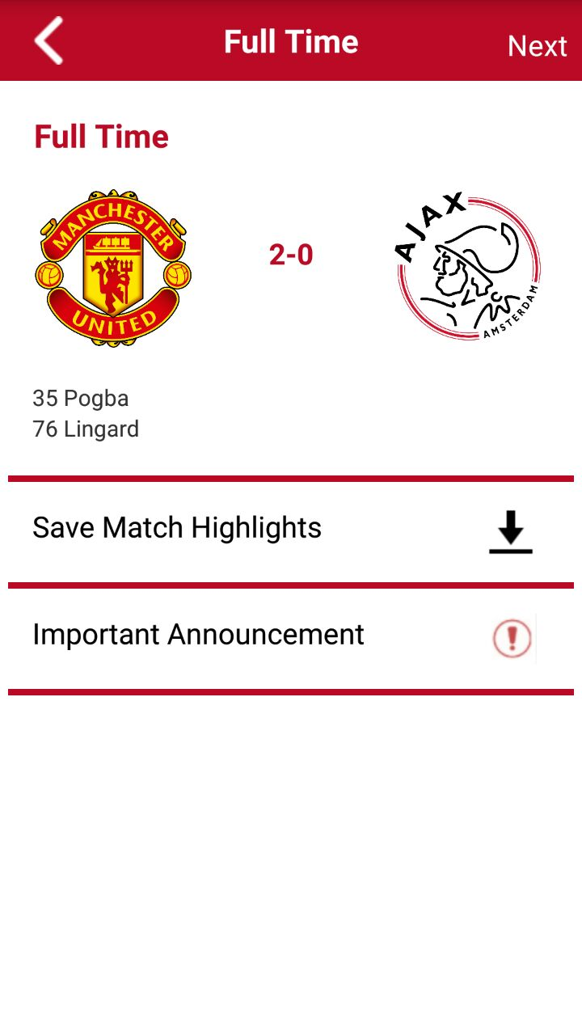
VIRTUAL JERSY
Dashboard
Deployment and Scalability
To demonstrate the app, we have made an admin panel linked to the local server.
Once the fields are submitted, the corresponding fields in the application are updated in real-time.
As the IP address of the network where the prototype may be tested is unknown, we have made a web page where the concept can be verified.
We can reconfigure the app with the static IP you provide us at the time of evaluation or deployment. Alternatively, please use the link here to verify the working of the concept. Other media will be pushed to the app using the same concept. http://www.goteso.com/test/vj/image-recognition/
Wireframe of the Dashboard is shown here

Slide 25
Github Link to RedDevils1999
https://github.com/khushalsukhadia/RedDevils1999-Museum-Tour-AR-Application
Museum Tour APK File – APK Folder > new-museum.apk
Museum Tour Trophy Images Folder - Trophy Images
Virtual Photo Booth APK File – APK Folder > ManutdAR.apk
Virtual Photo Booth Marker Images - Virtual Photo Booth - Markers
YouTube Link to the video - https://youtu.be/EtW-PrJPrwg

Slide 26

G G M U !!!
© Manchester United FC

